Slide 1
Enterprise Architecture Intern Projects
Application Development Project with Machine Learning Backend
Wiley Template Application and
Book Title Lookup Application

Slide 2
Template App Brief
Create a Single Page Application demonstrating use of the original 12 factors plus additional principles mentioned in "Beyond the 12 Factors".
The application should be built using API first principles.
The application should make use of standard Wiley Technologies.
The application should demonstrate 2 API integrations. One internal API, and one external 3rd party API.

Slide 3
Project Brief
Develop a proof of concept web application that looks up product title data from multiple systems and returns probable title matches and a confidence score for those title matches.
Use three systems:
GBPM: APP-221 Global BPM 1.0
Coltrane: APP-899 Coltrane
US CORE: APP-891 GlobalCORE 1.0
Definition of "product“
Book titles
The web app should have:
Title search feature (user input)
Back end machine learning process reading on the 3 data sets
Search results table of:
Title result
Confidence Score that result title is a match to the search title
System that the title result came from

Slide 4
Questions
For a search term, what are the similar product titles in multiple data sets?
Which system -- out of GBPM, CORE and Coltrane – is the search term in or not in?
What is the scope of duplicates across the systems based on the search term?

Slide 5
12(+) Factors
The Factors in Order of Priority
One codebase, one application
API first
Dependency management
Design, build, release, and run
Configuration, credentials, and code
Logs
Disposability
Backing services
Environment parity
Administrative processes
Port binding
Stateless processes
Concurrency
Telemetry
Authentication and authorization

Slide 6









Technologies for Web App
Function | Tool
Source Code Repository | Git
Backend Code | Java, Spring Boot
Frontend Code | React
Build Tool | Maven
Continuous Integration | Jenkins
Artifact Storage | Nexus
Testing | JUnit
Deployment Environment | AWS EC2
Data Storage | AWS RDS MySQL
Logging/Metrics | ELK Beats
Environment Management | Ansible

Slide 7
Establish Deployment Pipeline
Base Book Title Web App on Template
Build 12 Factor Template Web App
The Plan
Establish Deployment Pipeline
Base on Template on Book Title Web App
Build Book Title Web App
Reset in week 7 to prioritize Book Title Web App

Slide 8

Establish Deployment Pipeline
Base on Template App on Book Title App
Build Book Title App
Progress Made
All technologies acquired except Database
Git repo, Jenkins, AWS EC2
Deployment pipeline fully established and functional
Commit code -> Build -> Unit Test -> Package App -> Deploy to Nexus -> Deploy App from Nexus -> Test the App
Book Title App under development with plans for a working prototype available at the end of Week 9

Slide 9
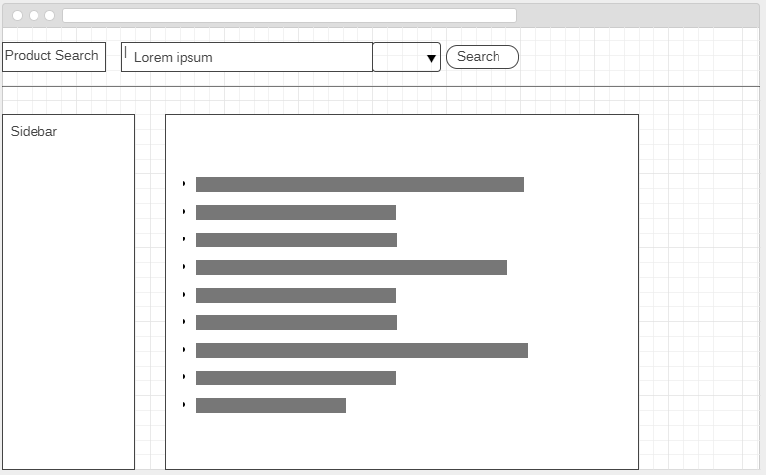
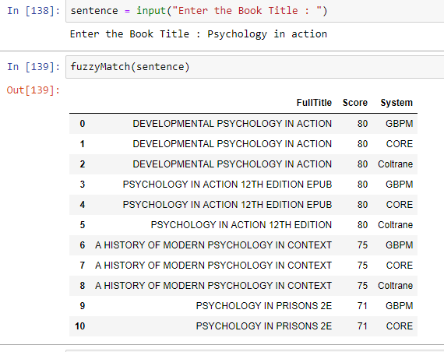
Definition of Working Prototype
Psychology In Action

Slide 10




Technologies used for Backend Machine Learning
Programming Language : Python
IDE: Jupyter Notebook, Spyder
Database : MySQL
Python libraries : Pandas, Fuzzywuzzy, Pymysql
Pandas : Library for Data Manipulation and Analysis
Fuzzywuzzy : Library for Fuzzy Matching (approximate matching)
Pymysql : Library that connects to MySQL server from Python

Slide 11
Fuzzy String Matching
Fuzzy String Matching also called Approximate String Matching, is the process of finding strings that approximatively match a given pattern.
For Example, both Wiley and John Wiley and Sons are the same company but for a computer these are completely different. Fuzzy String Matching solves this problem.
Using the Fuzzywuzzy library in Python for Fuzzy String Matching :
fuzz.WRatio('Wiley', 'John Wiley and Sons', 'Wiley Publishing’)
Output: 90 (Score which is out of 100)
Higher the score, higher the chance that the Strings are similar

Slide 12
Data Sources
Used partial Data Extracts from three systems :
GBPM: APP-221 Global BPM 1.0
Coltrane: APP-899 Coltrane
US CORE: APP-891 GlobalCORE 1.0

Slide 13
Data Preprocessing
Used the Full Title column to do Fuzzy matching
Check for missing values (Full Titles) in each systems
Remove the missing values
Convert the Titles into Uppercase
Remove the punctuations in the Titles
Remove whitespaces in the Titles
Combine the tables from the three systems to get a result table

Slide 14
Data Finding
The number of rows in the data extract from each system
GBPM : 10,765 rows
CORE : 10,766 rows
Coltrane : 10,766 rows
The result table has 32,297 rows (contains duplicates)
There are 14,093 unique Book Titles in the systems

Slide 15
Output

Slide 16
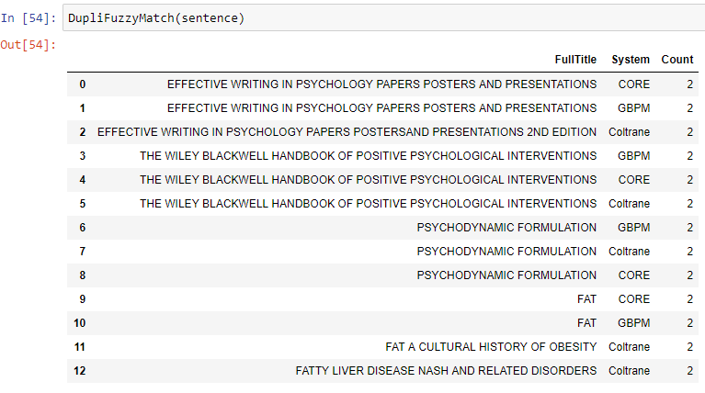
Output

Slide 17
Insights from the output
The output tells us :
the probable Book Title matches and a confidence score for those matches.
the different Book Title naming conventions for the systems.
the count of the occurrence of duplicate Book Titles and in which system they are present.

Slide 18
What’s Next?
What’s Next?
Gain access and setup the database
Continue development and optimization of Python scripts
Complete a working prototype of the Web Application

Slide 19
References
Python : https://www.python.org/
Jupyter Notebook : http://jupyter.org/
Spyder : https://pythonhosted.org/spyder/
MySQL Workbench : https://www.mysql.com/products/workbench/
Fuzzywuzzy Library : http://chairnerd.seatgeek.com/fuzzywuzzy-fuzzy-string-matching-in-python/

